Slide 1
Talking Between Services with gRPC
Marc Gravell
marc.gravell@gmail.com @marcgravell

Slide 2
Talking Between Services with gRPC
Marc Gravell, @marcgravell, marc.gravell@gmail.com
Architecture Team, Stack Overflow
Microsoft MVP
network focus, meta-programming focus
protobuf-net Dapper StackExchange.Redis FastMember (etc)
Notes:
00:00 – 00:30

Slide 3
Agenda
What is gRPC and why would I want to use it?
How would I use gRPC, today?
What are the strengths and weaknesses?
What is new in gRPC and .NET Core 3 (part 1)?
What is new in gRPC and .NET Core 3 (part 2)?
Summary
.
Notes:
0:30-2:30

Slide 4

The world of services
Notes:
2:30-3:30

Slide 5
What is gRPC and why would I want to use it?
RPC stack developed and used by Google
Open sourced in Feb 2015
Platform independent
High performance
Based on “protocol buffers” (“protobuf”) and HTTP/2
Necessary if talking to external services that are gRPC (e.g. Google)
A good choice for your own systems if you want efficient, robust, well-designed/implemented/tested, cross-platform RPC!
Great for micro-services!
Usually, gRPC is used with protobuf, so to understand gRPC, we first need to understand protobuf
.
Notes:
3:30-5:30

Slide 6
What is protocol buffers and why would I want to use it?
Binary serialization protocol designed and used by Google
(JSON variant added later, but doesn’t apply to gRPC)
Open sourced in July 2008
Platform independent
High performance
Low CPU to process
Low bandwidth to transmit
Version tolerant
.
Notes:
5:30-7:30

Slide 7
How would I use gRPC, today?
Notes:
7:30-17:30

Slide 8
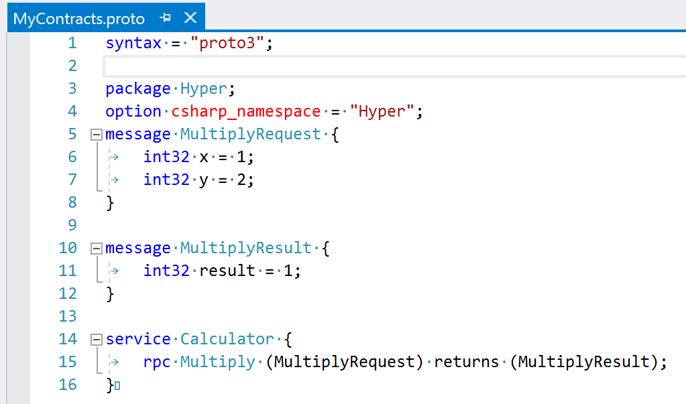
How would I use gRPC, today?
Notes:
7:30-17:30

Slide 9
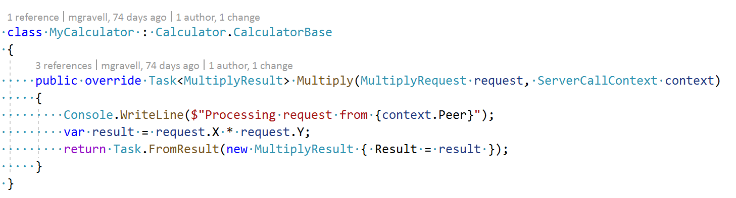
How would I use gRPC, today?
Notes:
7:30-17:30

Slide 10
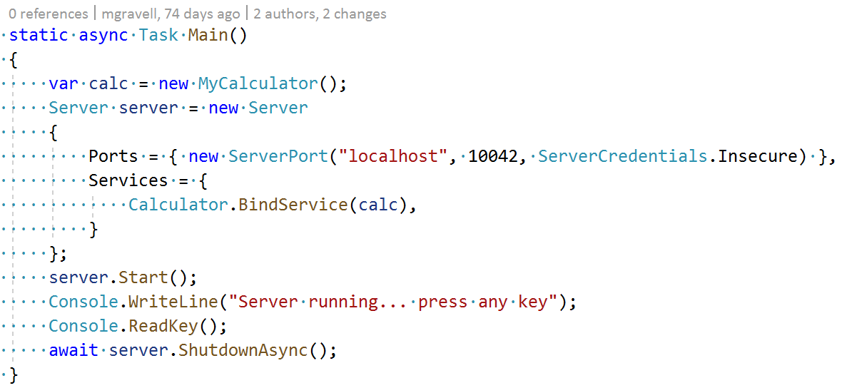
How would I use gRPC, today?
Notes:
7:30-17:30

Slide 11
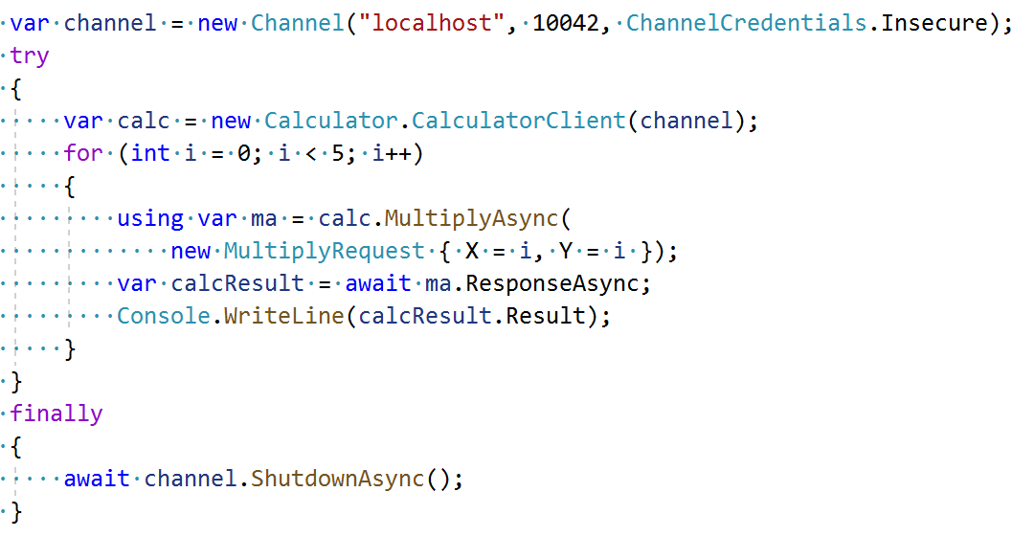
How would I use gRPC, today?
Notes:
7:30-17:30

Slide 12
How would I use it, today?
We should have seen:
Setting up a basic project with protobuf support
Creating a .proto schema
The generated code for data contracts, service clients, and service implementations
How to implement and host a service
How to create a client
A working client and server! (?)
Getting hold of metadata
Cancellations
(not covering security/auth, but those things exist etc)
.
Notes:
17:30-19:30

Slide 13
Today
(generated code)
Grpc.Core.Api
Grpc.Core
chttp2
Notes:
19:30-20:30

Slide 14
What are the strengths and weaknesses?
+ DSL is strong for cross-platform; same contract can be used from many languages / frameworks
- having to create and maintain the schema in .proto can be a nuisance for simple work
- awkward setup and tooling
+/- API is “idiomatic protobuf/gRPC, in C#” rather than “idiomatic .NET, doing protobuf/gRPC”
- code-gen is C#-only (for .NET-land)
- code-gen is proto3-only (for .NET-land)
- gRPC stack is native/unmanaged
and doesn’t play nicely with Kestrel, HttpClient, etc
- generated code with full implementation is verbose and restrictive
- the streaming API is … just weird!
.
Notes:
20:30-23:30

Slide 15
What is new in gRPC and .NET Core 3? (part 1)
Microsoft writing new libraries that work with the existing generated code for gRPC (HTTP/2) in managed code
New client bindings that use HttpClient
New server bindings that use Kestrel (ASP.NET Core server)
.
Notes:
23:30-25:30

Slide 16
Today
(generated code)
Grpc.Core.Api
Grpc.Core
chttp2
Notes:
25:30

Slide 17
.NET Core 3
Today
(generated code)
Grpc.Core.Api
Grpc.Net.Client
Grpc.Core
HttpClient
chttp2
Notes:
25:30-26:00

Slide 18
.NET Core 3
Today
.NET Core 3
(generated code)
Grpc.Core.Api
Grpc.Net.Client
Grpc.Core
Grpc.AspNetCore.Server
HttpClient
chttp2
ASP.NET Core
Notes:
26:00-26:30

Slide 19
What is new in gRPC and .NET Core 3? (part 1)
Notes:
26:30-31:30

Slide 20
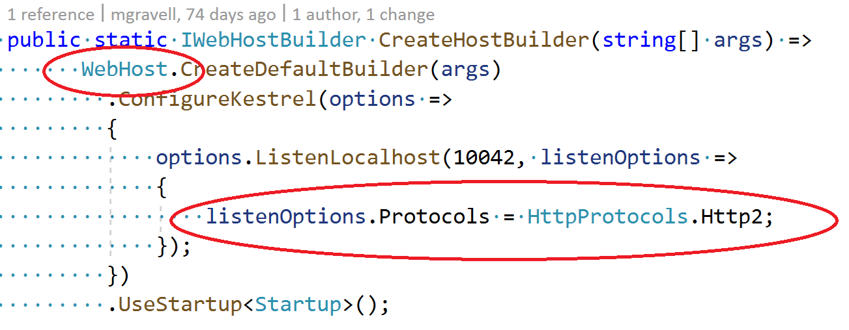
What is new in gRPC and .NET Core 3? (part 1)
Notes:
26:30-31:30

Slide 21
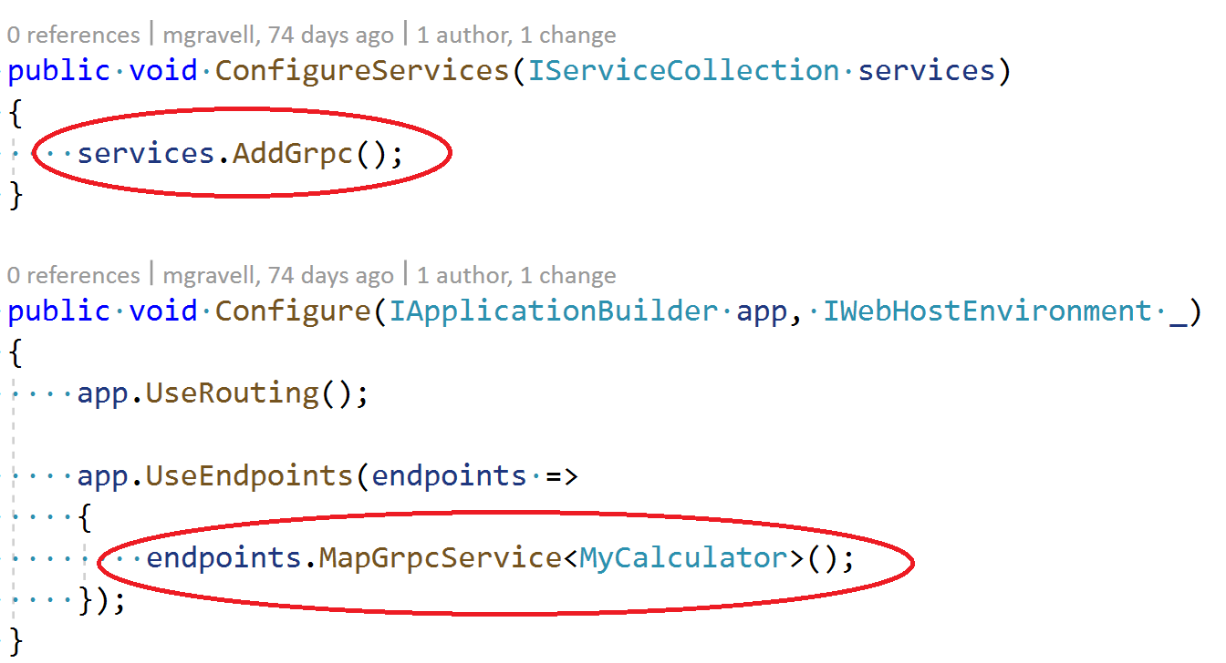
What is new in gRPC and .NET Core 3? (part 1)
Notes:
26:30-31:30

Slide 22
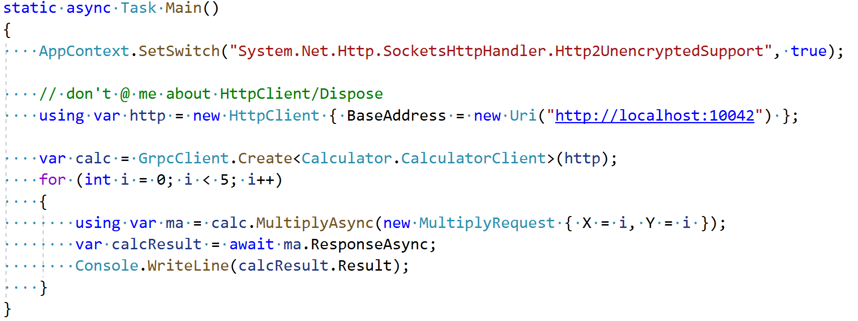
What is new in gRPC and .NET Core 3? (part 1)
Notes:
26:30-31:30

Slide 23
What is new in gRPC and .NET Core 3? (part 1)
We should have seen:
Creating a server in Kestrel
Creating a client with HttpClient
That other than actual setup of the client and server, everything else stays the same – just now: less unmanaged…
…which means we still have all the other pain points
.
Notes:
31:30-33:30

Slide 24
Today via Grpc
“contract-first”
.proto schema
(generated code)
Google.Protobuf
Grpc.Core.Api
Notes:
33:30-34:30

Slide 25
What is new in gRPC and .NET Core 3? (part 2)
New protobuf-net tooling (protobuf-net.Grpc)
Works against either the old unmanaged bindings or the new managed bindings, for both client and server
Defaults to protobuf-net (put configurable)
Re-imagines the API surface of services
Fully supports both code-first and contract-first styles of code
Supports both “proto2” and “proto3”
Isn’t limited to C#
…does anyone remember WCF?
(…I mean the good bits of WCF, not everything)
.
Notes:
34:30-35:30

Slide 26
Today via Grpc
“contract-first”
.proto schema
(generated code)
Google.Protobuf
Grpc.Core.Api
Notes:
35:30

Slide 27
Today via Grpc
protobuf-net.Grpc (preview)
“contract-first”
“code-first”
.proto schema
.NET types
(generated code)
(meta-programming)
Google.Protobuf
protobuf-net (…+?)
Grpc.Core.Api
Notes:
35:30-37:30

Slide 28
What is new in gRPC and .NET Core 3? (part 2)
Notes:
37:30-42:30

Slide 29
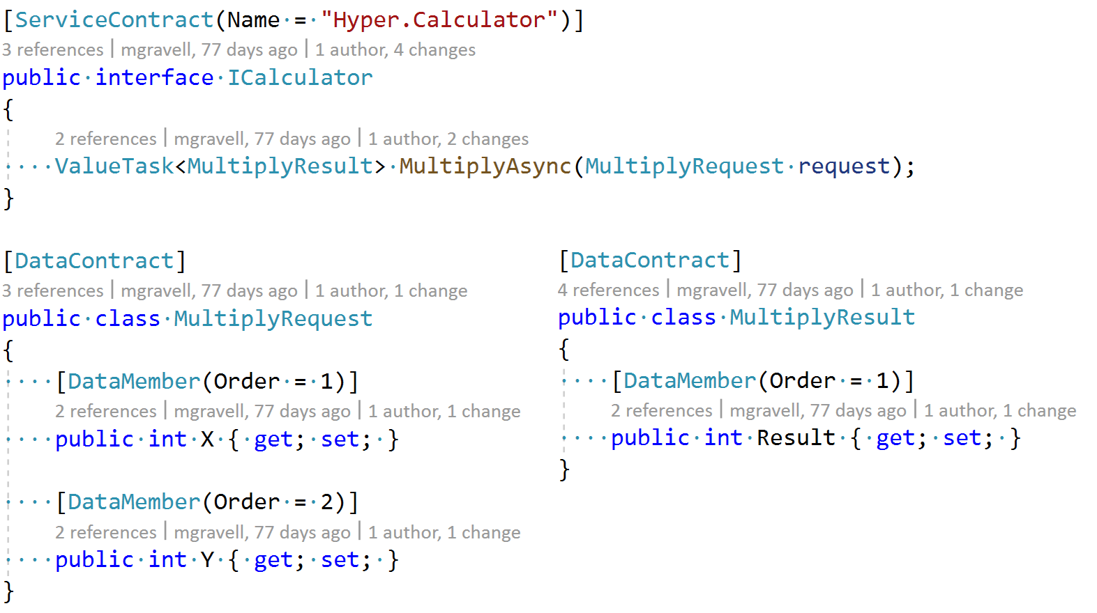
What is new in gRPC and .NET Core 3? (part 2)
Notes:
37:30-42:30

Slide 30
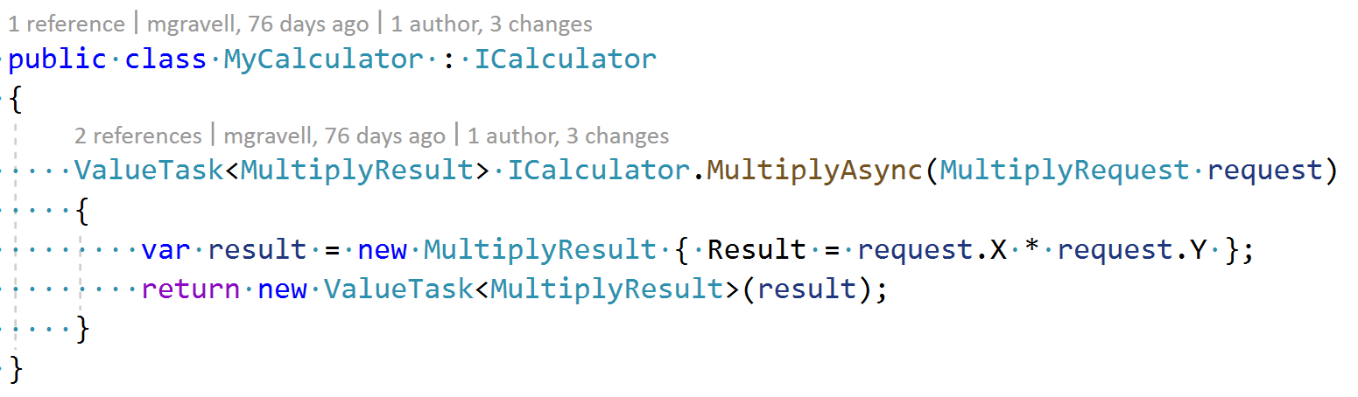
What is new in gRPC and .NET Core 3? (part 2)
Notes:
37:30-42:30

Slide 31
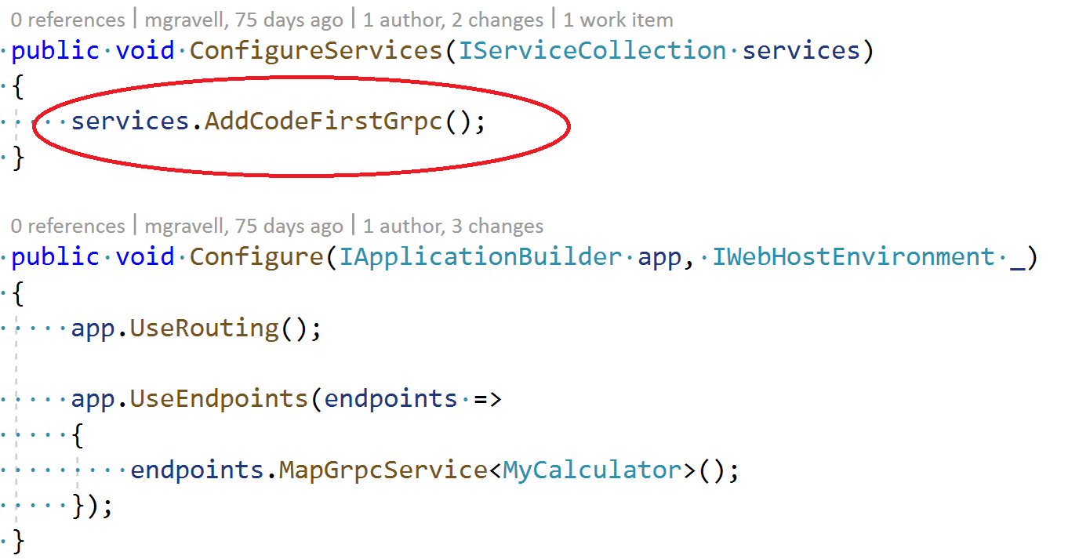
What is new in gRPC and .NET Core 3? (part 2)
Notes:
37:30-42:30

Slide 32
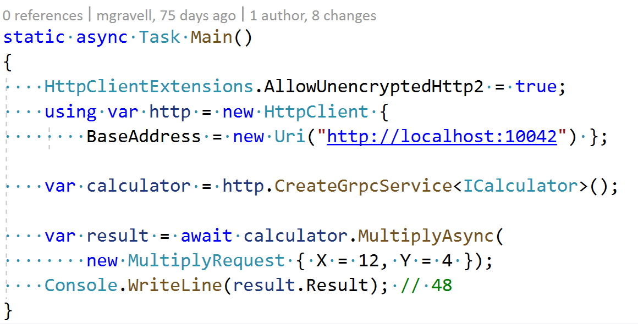
What is new in gRPC and .NET Core 3? (part 2)
Notes:
37:30-42:30

Slide 33
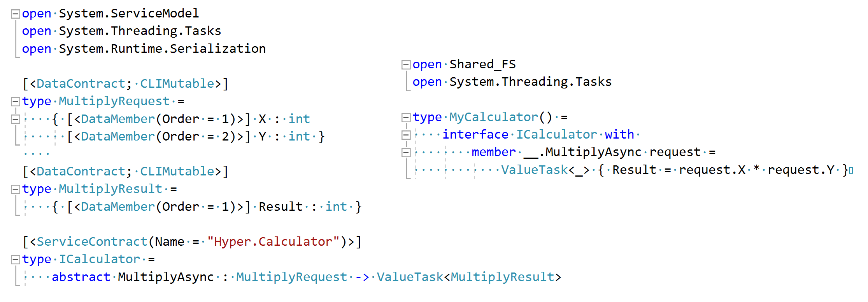
What is new in gRPC and .NET Core 3? (part 2)
Notes:
37:30-42:30

Slide 34
What is new in gRPC and .NET Core 3? (part 2)
We should have seen:
Defining our data and services in code as simple classes and interfaces
Creating a server (with either Grpc.Core or Kestrel)
Creating a client (with either Grpc.Core or HttpClient)
Creating nice clean code from a .proto schema
Using other languages
Idiomatic .NET code
Streaming made simple via asynchronous streams
Avoiding Grpc.Core means : no native libraries!
.
Notes:
42:30-43:30

Slide 35
Summary
gRPC is a great tool for general purpose calls between services
By default, it takes a little bit of effort; it may be more effort than simpler tools
The unmanaged implementation makes deployment awkward
With .NET Core 3, Microsoft have fixed half of the wrinkles…
…and tools like protobuf-net.Grpc can be used to fix the other half
(other similar tools exist; MagicOnion, etc)
Google gRPC bits RTM for ages; all other bits now RTM with .NET Core 3
Please feel free to come and find me to discuss in more depth!
.
Notes:
43:30-44:30

Slide 36
https://github.com/grpc/grpc
https://github.com/grpc/grpc-dotnet https://github.com/protobuf-net/protobuf-net.Grpc
THANKS!
(and questions?)
Marc Gravell
marc.gravell@gmail.com @marcgravell

